Slide 1
Data Modeling

Slide 2
Introduction
describes the data that flow through the business processes in an organization
During the analysis phase, the data model presents the logical organization of data without indicating how the data are stored, created, or manipulated so that analysts can focus on the business without being distracted by technical details.
Later, during the design phase, the data model is changed to reflect exactly how the data will be stored in databases and files

Slide 3
Introduction
how the data that flow through the processes are organized and presented
A data model is a formal way of representing the data that are used and created by a business system
The data model is drawn by an iterative process in which the model becomes more detailed and less conceptual over time.
Project teams usually use CASE tools to draw data models

Slide 4
ERD
we focus on creating a logical data model.
We will present one of the most commonly used techniques:
entity relationship diagramming (ERD): graphic drawing technique developed by Peter Chen that shows all the data components of a business system
An entity relationship diagram (ERD) is a picture which shows the information that is created, stored, and used by a business system
On an ERD, similar kinds of information are listed together and placed inside boxes called entities.
Lines are drawn between entities to represent relationships among the data, and
special symbols are added to the diagram to communicate high-level business rules that need to be supported by the system.

Slide 5
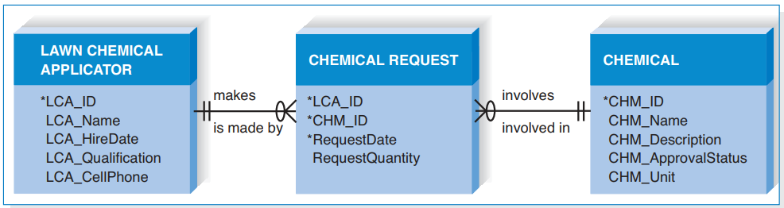
Reading an Entity Relationship Diagram

Slide 6
Reading an Entity Relationship Diagram
The ERD also communicates high-level business rules
Business rules are constraints or guidelines that are followed during the operation of the system
A customer may place many orders
we know from the “crow’s foot” placed on the line closest to the Chemical Request that an LCA may make many Chemical Requests
We can see by the two bars placed on the line closest to the LCA that a Chemical Request is made by exactly one LCA

Slide 7
Elements of an Entity Relationship Diagram
three basic elements in the data modeling language
entities,
attributes, and
Relationships
each of which is represented by a different graphic symbol

Slide 8
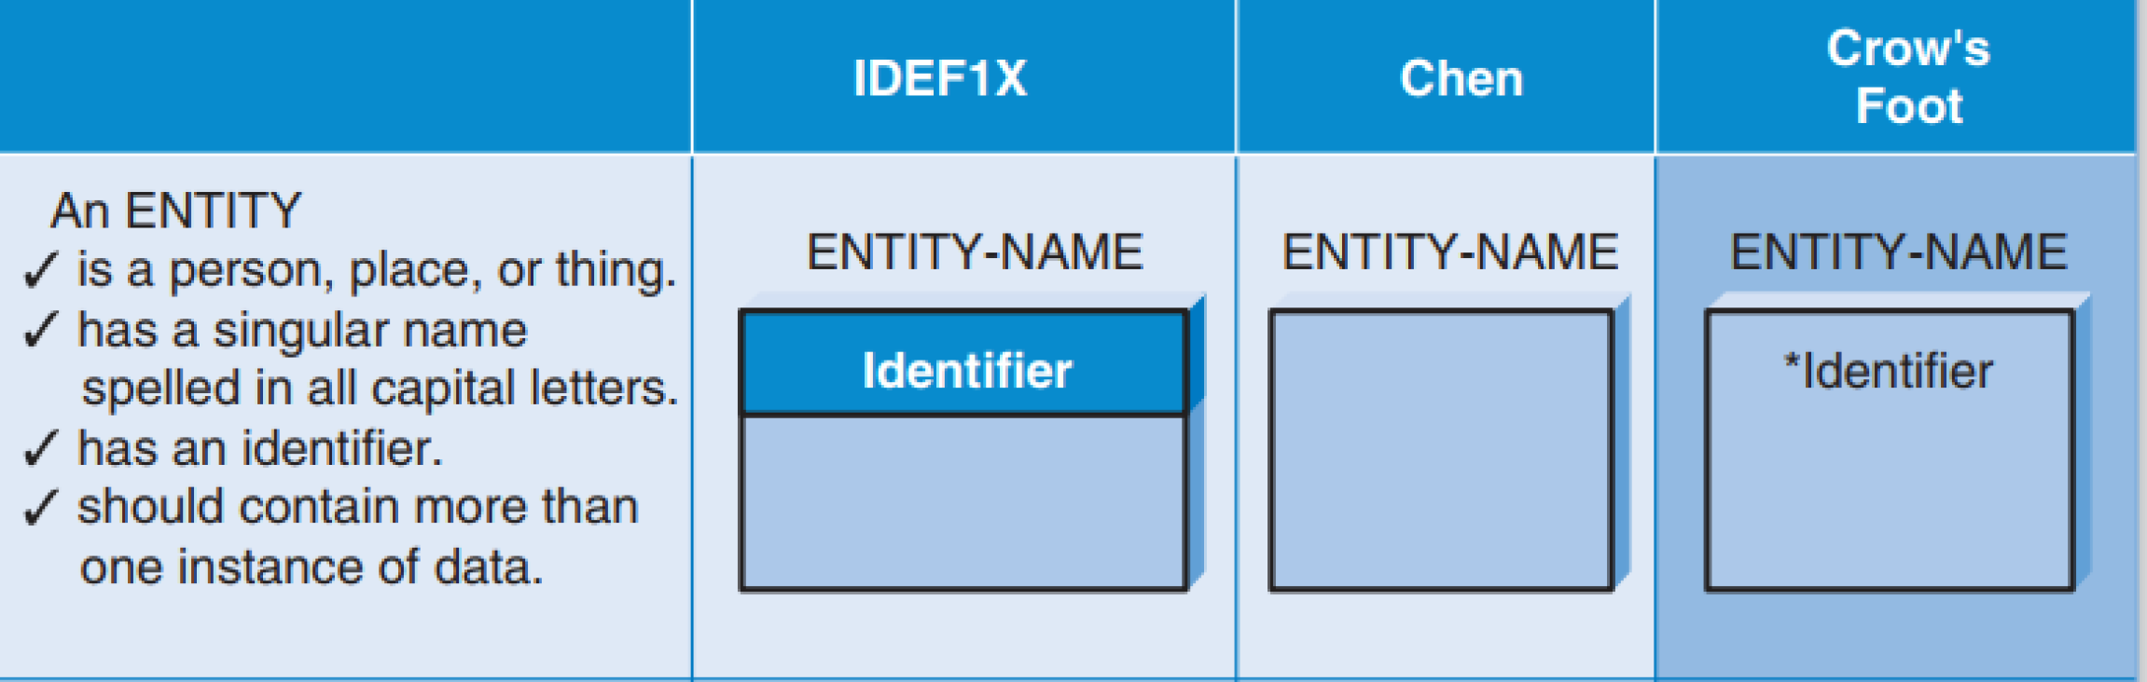
Entity

Slide 9
Entity
basic building block for a data model
a person, place, event, or thing about which data is collected
it is described by a singular noun spelled in capital letters
All entities have a name, a short description that explains what they are, and an identifier that is the way to locate information in the entity
Entities represent something for which there exist multiple instances, or occurrences

Slide 10
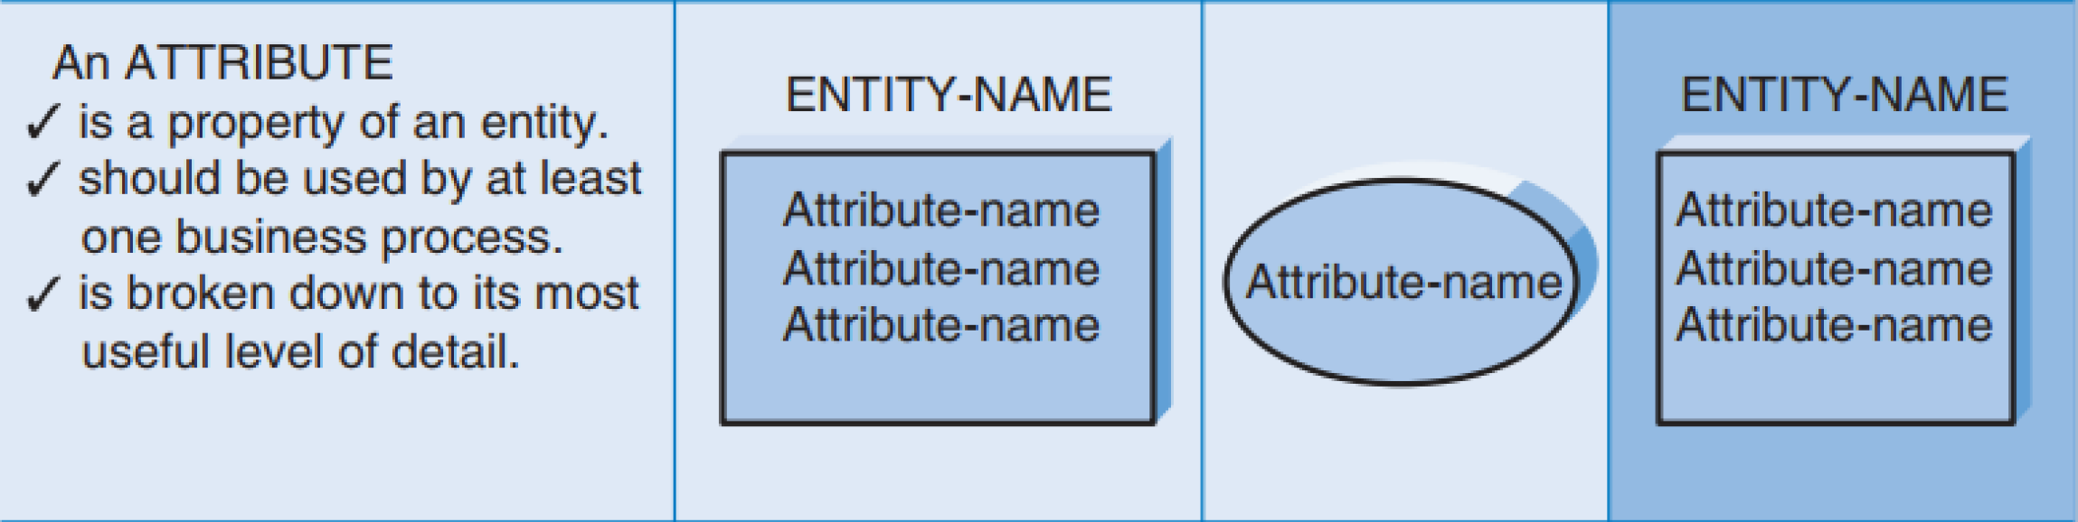
Atteribute

Slide 11
Attribute
An attribute is some type of information that is captured about an entity
last name, home address, and e-mail address
Attributes are nouns that are listed within an entity
Usually, some form of the entity name is appended to the beginning of each attribute to make it clear as to what entity it belongs
CUS_address
One or more attributes can serve as the identifier (uniquely identify one instance of an entity)

Slide 12
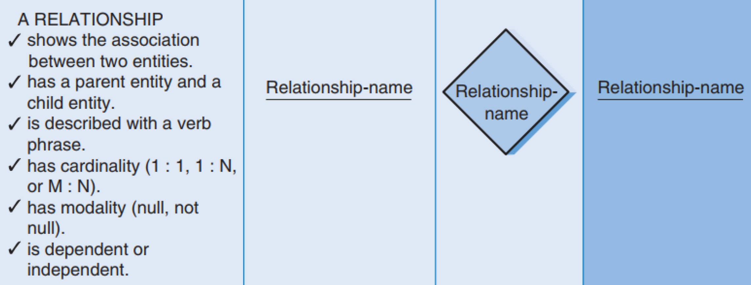
Relationship

Slide 13
Relationship
Relationships are associations between entities
Every relationship has a parent entity and a child entity, the parent being the first entity in the relationship, and the child being the second
labeled with active verbs so that the connections between entities can be understood
the top words are read from parent to child, and the bottom words are read from child to parent
Relationships have two properties
Cardinality
Modality

Slide 14
Cardinality
the ratio of parent instances to child instances.
“How many instances of one entity are associated with an instance of the other?”
1:1, 1:N, or M:N
As we will learn later, there are advantages to eliminating M:N relationships from an ERD, so that is why it was removed from the last Figure by creating the Chemical Request entity between LCA and Chemical.

Slide 15
Modality
whether the child-entity instance is required to participate in the relationship
It forces you to ask questions like,
Can you have a Chemical Request without a Chemical? NO
Can you have a Chemical without a Chemical Request? Yes
A bar is placed on the relationship line next to the parent entity if nulls are not allowed
Zero if null
The modality is “not null,” or “required,” for the first relationship in our Figure. Notice, however, that a zero has been placed on the relationship line between Chemical and Chemical Request next to the Chemical Request entity.

Slide 16
The Data Dictionary and Metadata
Every CASE tool has something called a data dictionary, which quite literally is where the analyst goes to define or look up information about the entities, attributes, and relationships on the ERD
The information you see in the data dictionary is called metadata
data about data
Metadata is anything that describes an entity, attribute, or relationship
Metadata are stored in the data dictionary so that they can be shared and accessed by developers and users throughout the SDLC.

Slide 17
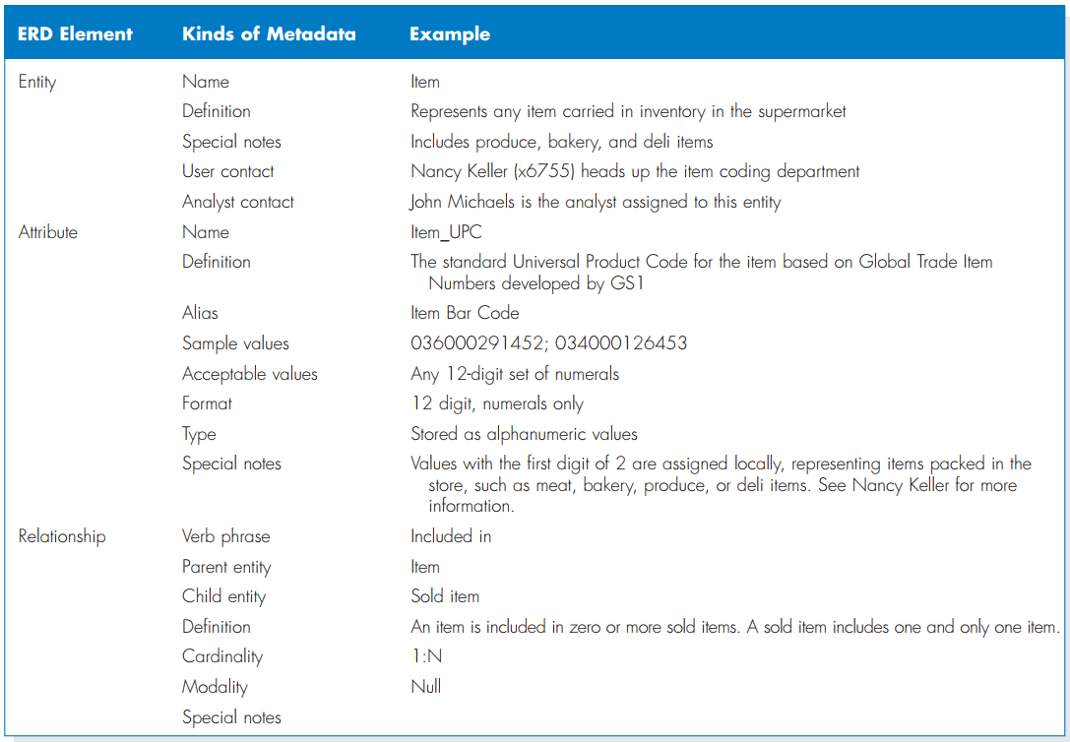
Meta-Data

Slide 18
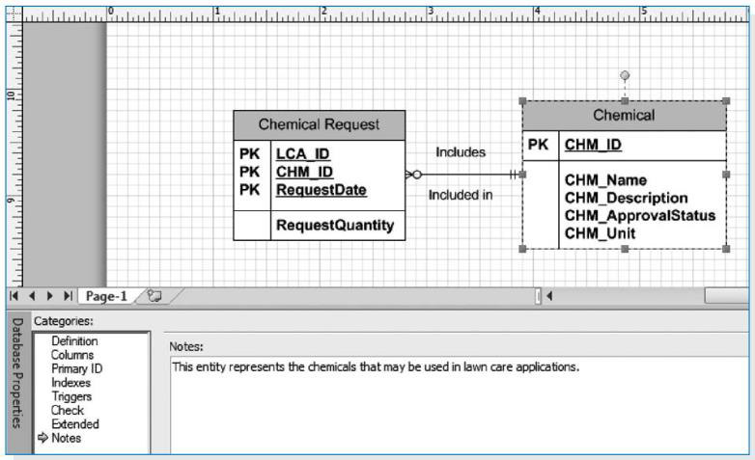
VISIO 2010

Slide 19
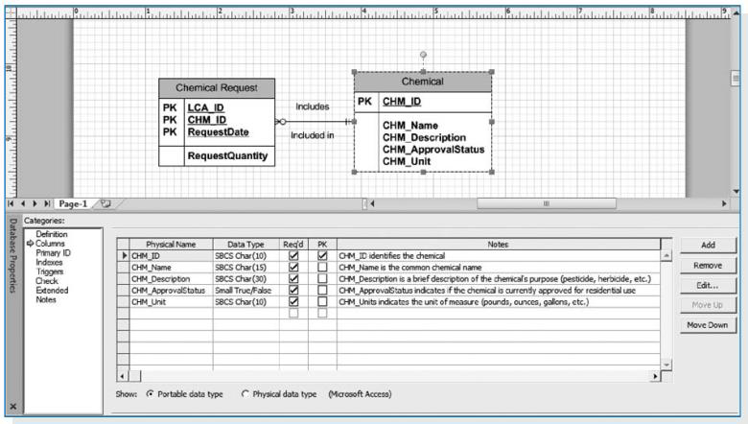
VISIO 2010

Slide 20
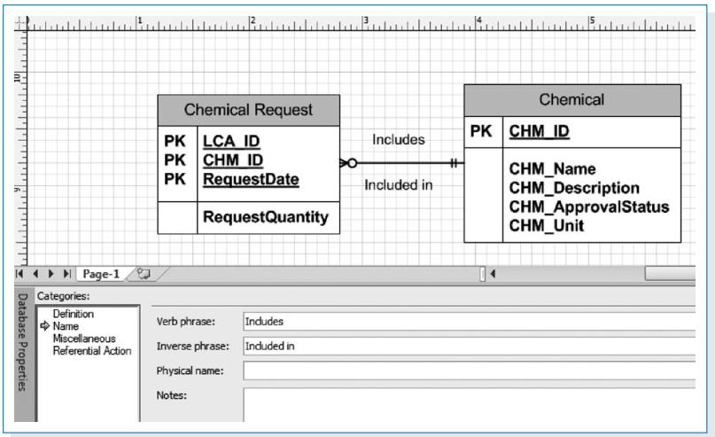
VISIO 2010

Slide 21
Building Entity Relationship Diagrams Steps
Step 1: Identify the Entities
identify the entities for the model, and their attributes.
major categories of information that you need to store in your system.
using a use case, look at the major inputs to the use case, the major outputs, and the information used for the use case steps.
If the process models (e.g., DFDs) have been prepared, the data stores on the DFDs, the external entities, and the data flows indicate the kinds of information that are captured and flow through the system.

Slide 22
Building Entity Relationship Diagrams Steps
Step 2: Add Attributes and Assign Identifiers
information that describes each entity becomes its attributes
How to identify them
The elements of the DFD should be added to the ERD as attributes in your entities
check the requirements definition
use requirements elicitation techniques (interviews)
Once the attributes are identified, one or more of them will become the entity’s identifier.
The identifier must be an attribute(s) that is able to uniquely identify a single instance of the entity.

Slide 23
Building Entity Relationship Diagrams Steps
Step 3: Identify Relationships
how the entities are related to each other
each relationship is labeled, and cardinality and modality is assigned.
The easiest approach is to begin with one entity and determine all the entities with which it shares relationships.
For cardinality, ask how many instances of each entity participate in the relationship
Next, we examine the relationship’s modality. Can an LCA exist without an associated chemical request?

Slide 24
REMEMBER
Data modeling is an iterative process.
Often, the assumptions you make and the decisions you make change as you learn more about the business requirements and as changes are made to the use cases and process models.

